Slide 1

Products classifier
Sorrentino Alessandro, 815999
Ratti Burt, 816243
Zuccarella Stefano, 816482

Slide 2
Objective
Obtain an image containing a different number of objects.
Recognize each product through classification.
Return type of objects and total price (receipt).

Slide 3
Preconditions
The implementation of the algorithm was done on Matlab.
The images were taken from above at a constant distance d ± ε, in order to have more or less the same size for the objects.
The lighting is slightly not homogeneous because of flash (radial illumination from the center).
Objects can slightly touch other objects and they can be rotated in different ways.
Objects should have as less shadows as possible.

Slide 4
Objects to recognize
Algida
Aranciata
Cioccolato
CocaCola
Ghiaccioli
Integrale
Limone
Mandarino
Mela
Milka
Passata
Pasta
Sprite
The
Tonno
Viviverde
Yomo
Unknown Class

Slide 5
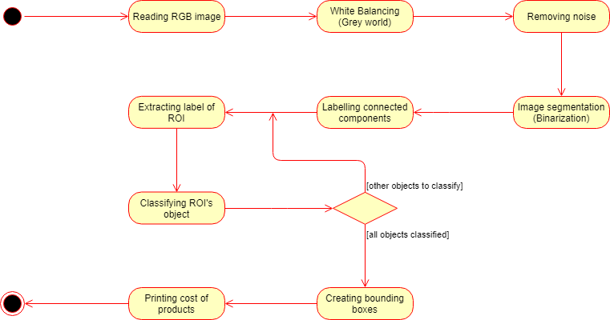
Pipeline

Slide 6
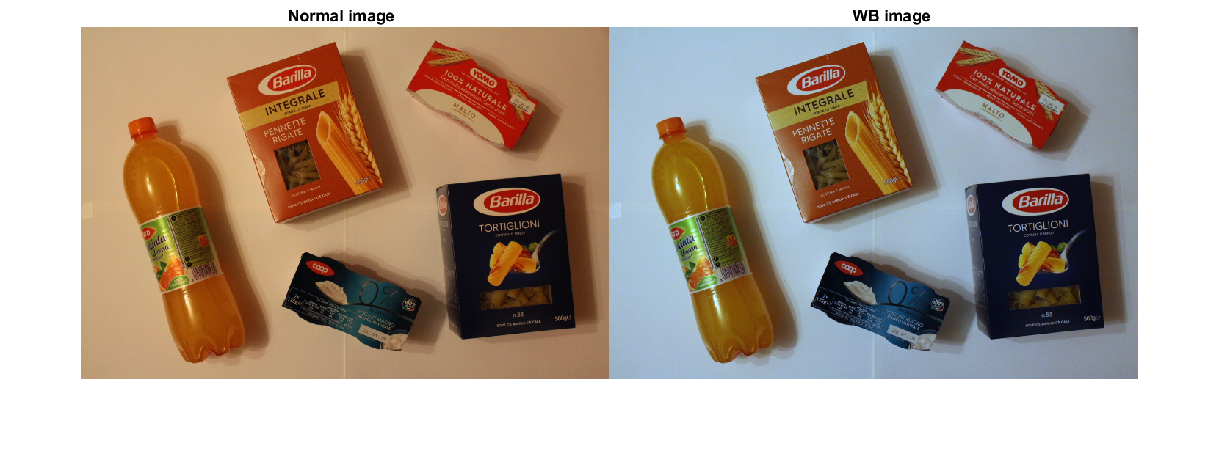
White Balancing

